Slide 1
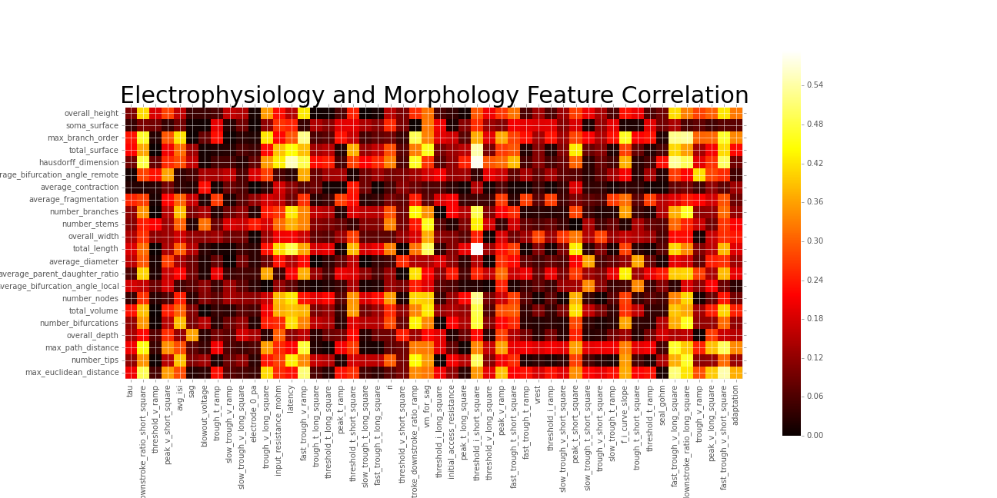
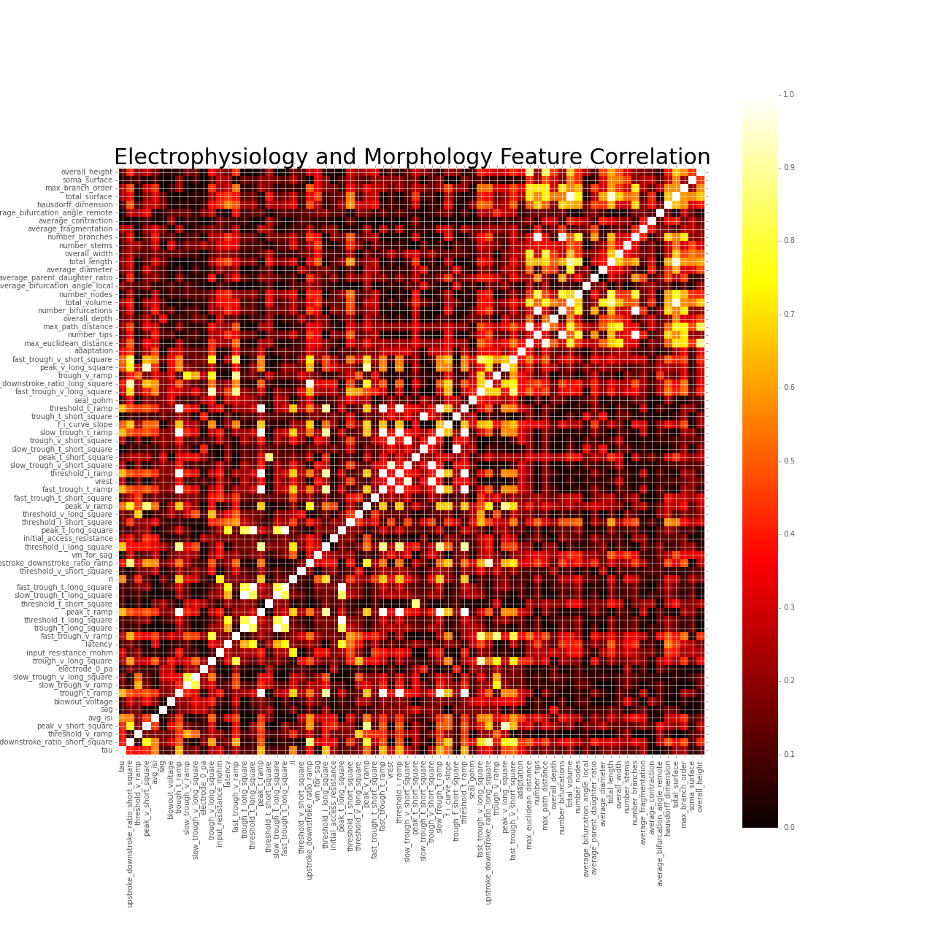
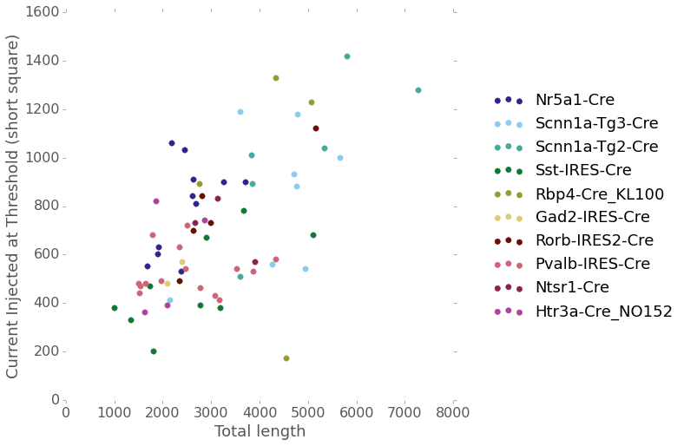
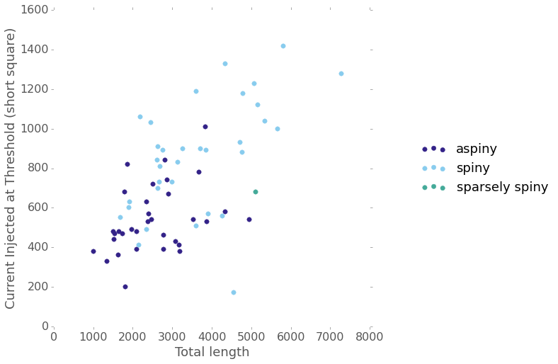
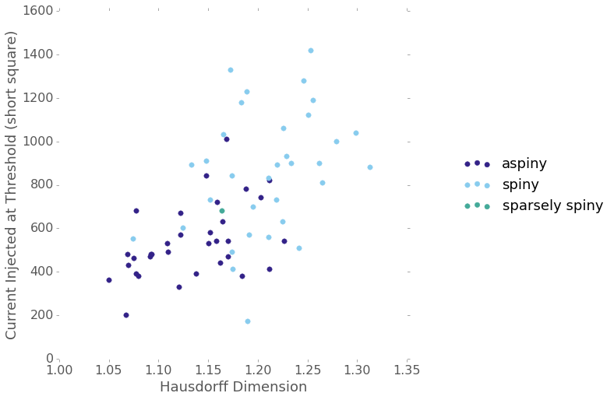
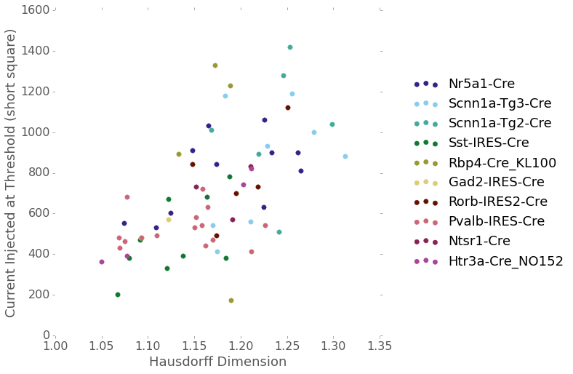
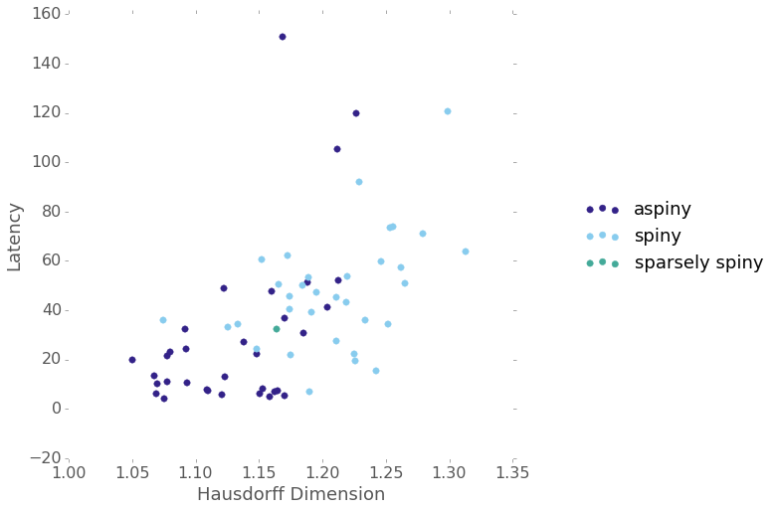
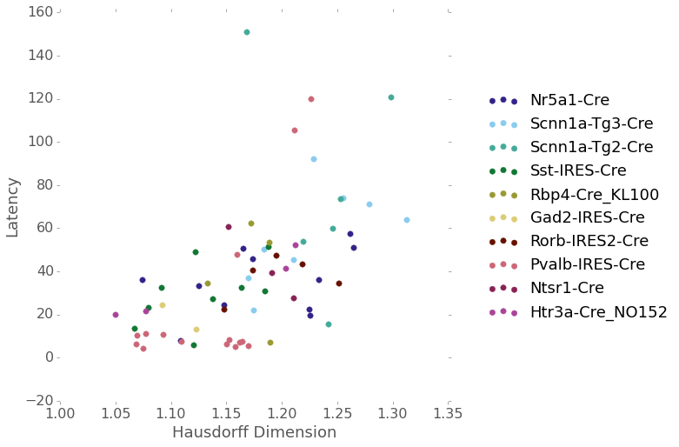
Cell Feature Relationships
Next steps
Dimensionality reduction (PCA)
Classification (Support vector machine)
Can ephys features predict morphology features?
Can morphology features predict ephys features?
Methods
Survey feature correlations for cells with both ephys and morphology data (n=67)
Investigate feature pairs with highest correlations in more detail
Can we predict anything about a cell’s morphology given it’s electrophysiological features (or vice versa)?
How are a cell’s electrophysiological features related to its morphology?
Aiva Ievins
Summer Workshop on the Dynamic Brain
August 29, 2015
…Questions? Comments? Ideas?

